Slide 1
Lecture 05: Distribution
Chris Walshaw
Computing & Mathematical Sciences
University of Greenwich

Slide 2
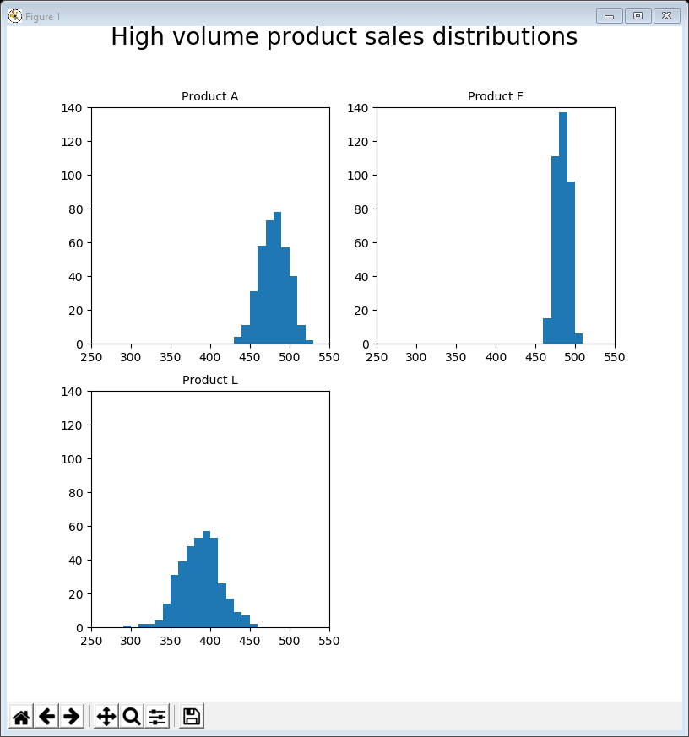
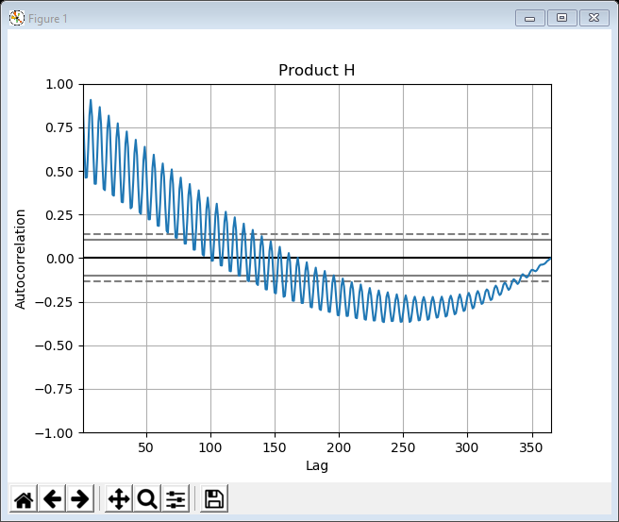
Motivation / Objectives
The company who supplied the data want to know about products that
don’t sell well or
aren’t very profitable or
cost too much to market or …
Last week we looked at correlations
it was evident that the sales of some products were (possibly) related through peaks and troughs
it was also clear from the previous week that the sales data was “noisier” for some products than others
This week we will investigate distribution, seasonality and outliers via
histograms & box plots
autocorrelation & seasonal decomposition
annotation

Slide 3
Common features
Once again, most of today’s examples contain the same lines of code at the top
import the libraries & read in the data
After which there are a number of different techniques to apply
And we shall also meet (briefly) another library, called StatsModels, for the seasonal decomposition examples
import matplotlib.pyplot as plt
import pandas as pd
data = pd.read_csv('https://tinyurl.com/ChrisCoDV/Products/DailySales.csv',
index_col=0)
pd.plotting.register_matplotlib_converters()
data.index = pd.to_datetime(data.index)

Slide 4
Distribution
Distribution or frequency distribution describes how a variable is distributed
For example if we measured temperature in the same location in the UK location over a year we might expect
most values to lie somewhere between say 5 and 25 degrees with perhaps an average of 15
there are occasional extremes going up to perhaps 32 or down to -2
However, in other parts of the world (e.g. California) the spread is narrower
most values to lie somewhere between say 20 and 30 degrees with perhaps an average of 25
there are occasional extremes going up to perhaps 35 or down to 15

Slide 5
Deviation / Outliers
Statistics has a way of describing the spread of values called the standard deviation
for the UK, the standard deviation would be something like 5 and for California it would be closer to 2.5
Assuming the data is normally distributed …
as it often is, although normal is actually a technical term with very specific meaning
… then 68% of all measurements will be within 1 standard deviation of the mean and 95% will be within 2 standard deviations
so for the UK, the mean is 15 and if the standard deviation is 5 then 95% of all measurements are within the 5 to 25 range (= 15 ± 2 x 5)
for California, the mean is 25 and if the standard deviation is 2.5 then 95% of all measurements are within the 20 to 30 range (= 25 ± 2 x 2.5)
Very extreme values are known as outliers
no standard statistical definition but matplotlib describes how it calculates them at https://matplotlib.org/api/_as_gen/matplotlib.pyplot.boxplot.html
There are two standard ways of visualising distributions, deviations and outliers, each with their own advantages: histograms and box plots

Slide 6
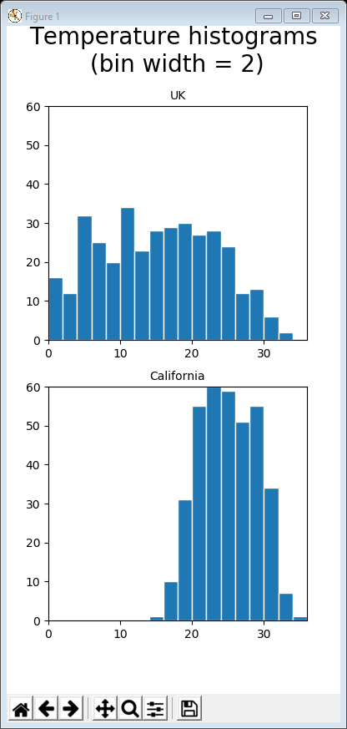
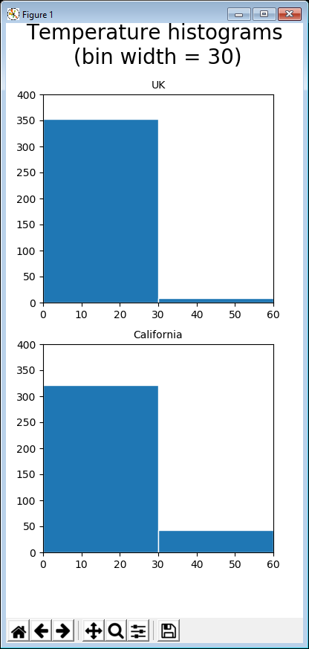
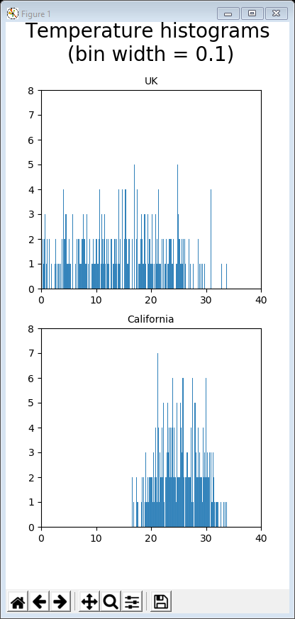
Histograms
Histograms show frequencies that values appear using a set of bins
each bin represents a range of values, e.g. 20 to 22, 22 to 24, 24 to 26, etc
the data is sorted and put in the appropriate bin (e.g. 23.7 is put in the 22 to 24 bin)
the number of values in each bin are counted up and visualised as a bar with height representing the number of values in the bin (which is why histograms are sometime confused with bar charts)
If you have too few bins the visualisation is pointless
e.g. if there a bin representing 0 to 30 almost all of the values will go in it
On the other hand if you have too many bins the visualisation is also of limited use
e.g. if the bins are very narrow there might just a few values in each bin with several empty bins
But there is no “correct” number of bins
you will need to experiment … between 10 and 50 is usually regarded as a suitable number

Slide 7
Choosing the number / size of bins
Can let MatPlotLib decide how many bins
Or can tell it how many bins to create, e.g. bins=10 or bins=50
Or can be more precise about where the bins start and end and what the bin width is
in the above code, you choose x_min, x_max and bin_width and the bins are created for you
x_min = 0
x_max = 40
bin_width = 2
n_bins = int((bin_width + x_max - x_min) / bin_width)
print(str(n_bins) + ' bins')
bins = [(x_min + x * (bin_width + x_max - x_min) / n_bins)
for x in range(int(n_bins))]

Slide 8
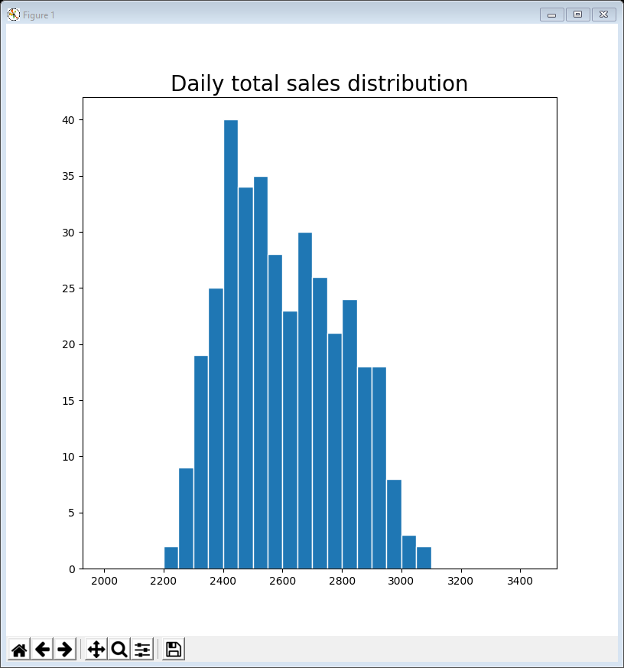
01Histogram daily total sales.py
The following code creates a histogram of total sales of all products calculated for each day
e.g. on 1/1/2019: 526 of product A, 3 of B, etc and in total 2,704 items
The single line in bold actually creates the histogram
axis=1 tells Pandas to do a sum along each row, rather than each column
The distribution is approximately normal (bell shaped), slightly skewed left
The height of the tallest column is 40 for the bin 2400 to 2450
so there were 40 days where total sales were between 2400 and 2449
x_min = 2000
x_max = 3500
bin_width = 50
n_bins = int((bin_width + x_max - x_min) / bin_width)
print(str(n_bins) + ' bins')
bins = [(x_min + x * (bin_width + x_max - x_min) / n_bins)
for x in range(int(n_bins))]
plt.figure(figsize=(8, 8))
plt.hist(data.sum(axis=1), bins=bins, edgecolor='w')
plt.title('Daily total sales distribution', fontsize=20)
plt.show()

Slide 9
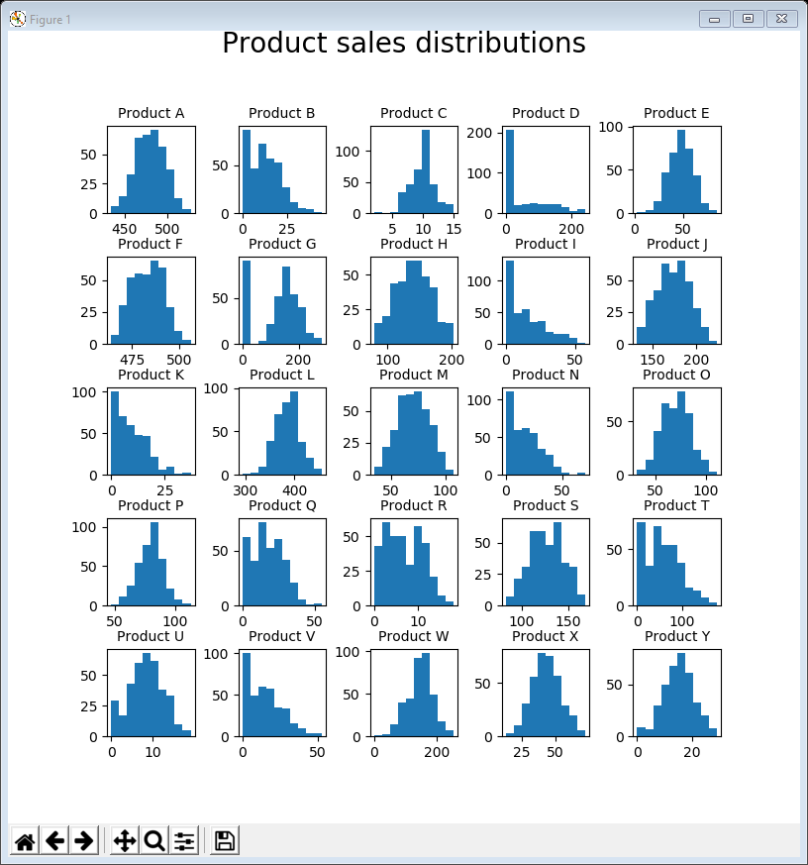
02Histogram all subplots.py
Using the same ideas as last week about creating subplots / facets, the following code plots the distributions for all 25 products
Because they are so varied we let MatPlotLib decide on the bins
The single line in bold actually creates the histogram
because MatPlotLib decides on the bin sizes the axes aren’t directly comparable
Some distributions are very clearly normal (e.g. A, E, H, etc)
Some are left skewed particularly by zero values (e.g. D, G, I, N)
the distribution for G clearly shows there are a lot of zeroes
counter = 1
fig = plt.figure(figsize=(8, 8))
fig.suptitle('Product sales distributions',
fontsize=20, position=(0.5, 1.0))
for name in data:
sub = fig.add_subplot(5, 5, counter)
sub.set_title('Product ' + name, fontsize=10)
sub.hist(data[name], edgecolor='w')
counter += 1
plt.subplots_adjust(wspace=0.5, hspace=0.5)
plt.show()

Slide 10
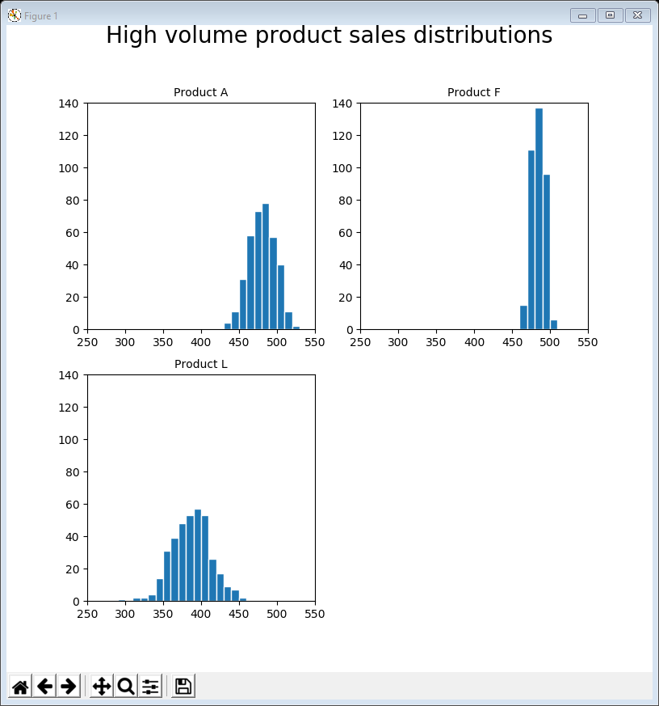
03Histogram high volume subplots.py
The following code restricts the visualisation to the high volume products but with all subplots using the same bins so that they can be directly compared
we also need to set the x & y limits to be the same for each plot
We see that they are all roughly normal distributions but that F has a much narrower spread (smaller standard deviation)
x_min = 250
x_max = 550
bin_width = 10
... # the bin calculations go here
fig = plt.figure(figsize=(8, 8))
fig.suptitle('High volume product sales distributions',
fontsize=20, position=(0.5, 1.0))
counter = 1
for name in selected:
sub = fig.add_subplot(2, 2, counter)
sub.set_title('Product ' + name, fontsize=10)
sub.hist(data[name], bins, edgecolor='w')
sub.set_xlim(xmin=x_min, xmax=x_max)
sub.set_ylim(ymin=0, ymax=140)
counter += 1
plt.show()

Slide 11
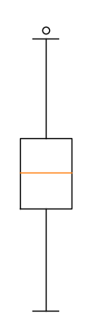
Box plots
Box plots are also used for visualising distribution, but rather than displaying frequency they summarise important aspects of the distribution
MatPlotLib provides box-and-whisker plots where
the middle 50% of measurements are within the box
the median line is shown (in the box)
the whiskers show the distribution beyond the box – each whisker may be up to 1.5 times the length of the box
any values beyond the end of the whisker are outliers
outlier & maximum
whisker
median
box (50% of data)
whisker
minimum

Slide 12
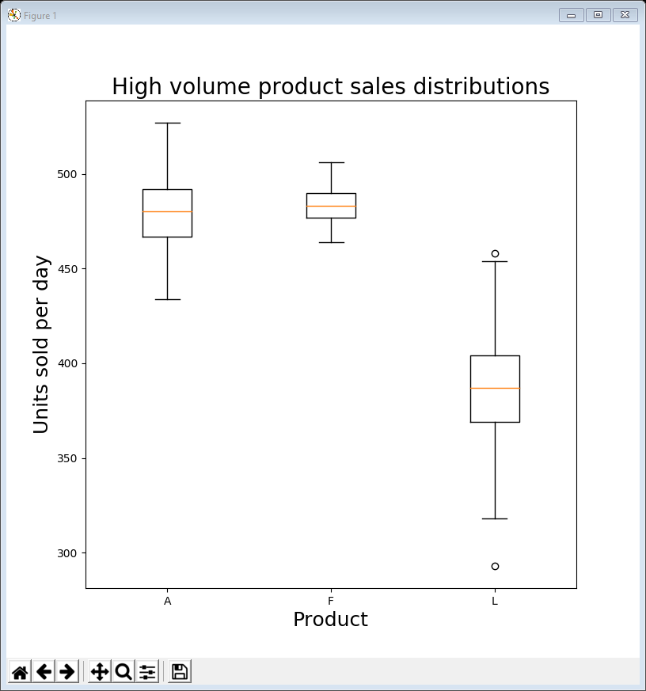
04BoxPlot high volume.py
The following code visualises the box plots for high volume products
The single line in bold actually creates the box plots for the selected columns
need to .transpose() the data for the box plot to work
Once again it shows that product F has much narrower spread
selected = ['A', 'F', 'L']
plt.figure(figsize=(8, 8))
plt.boxplot(data[selected].transpose(), labels=selected)
plt.xlabel('Product', fontsize=18)
plt.ylabel('Units sold per day', fontsize=18)
plt.title('High volume product sales distributions',
fontsize=20)
plt.show()

Slide 13
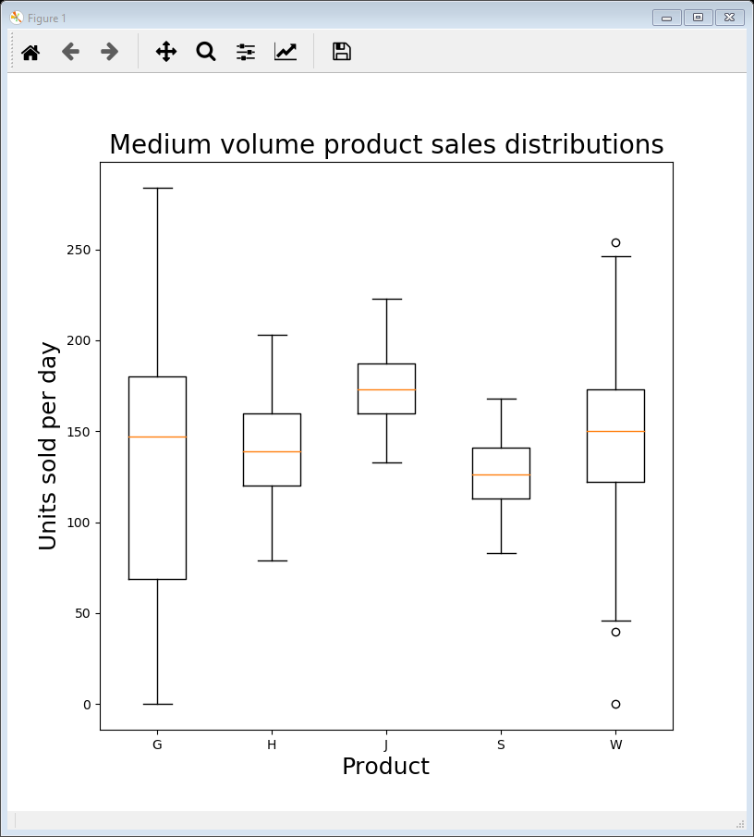
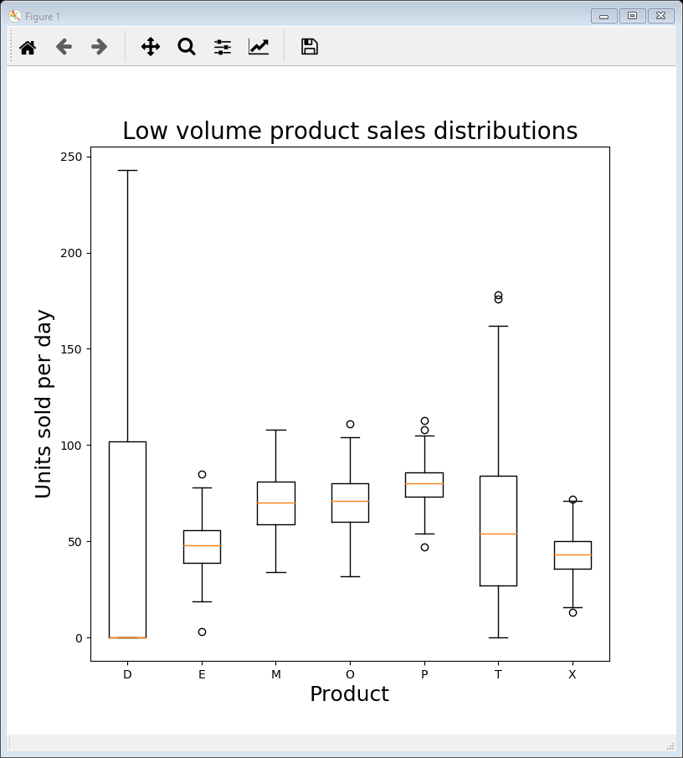
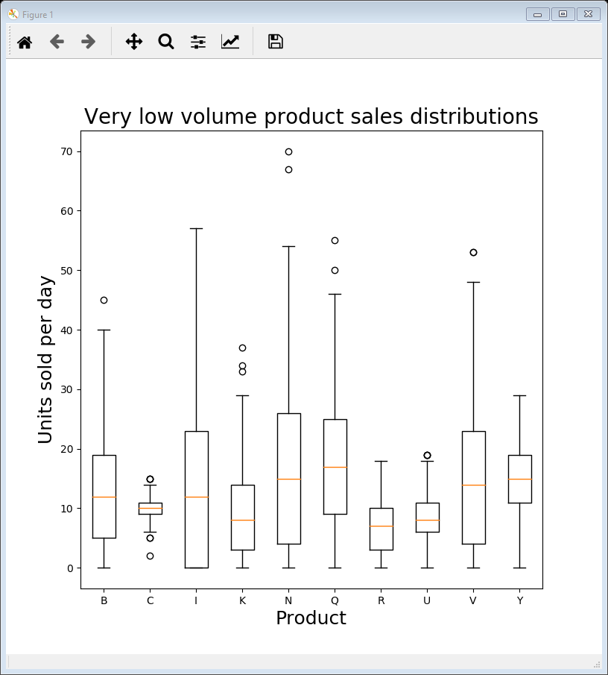
Examples 05, 06 & 07
Examples 05, 06 & 07 show box plots for medium, low & very low volume products
the only change in the code is the selected list
Makes sense to show segmented plots (medium / low / very low) as the scales are so different

Slide 14
Seasonal variation
Whilst histograms and box plots are a very useful tool in the data visualisation toolbox they are perhaps not so useful for this dataset
the spread may come from trends over time and histograms / box plots tell us nothing about time
Recall from last week that it looked like some products had regular seasonal peaks and troughs / fluctuations
This is known as seasonality (or periodicity / periodic behaviour)
It can arise from various causes, e.g.
temperatures are regularly colder in the winter / hotter in the summer
sales of some products (food, alcohol) can be higher at the weekend
sales can be impacted by regular events such as promotions / clearances / catalogue launches / …

Slide 15
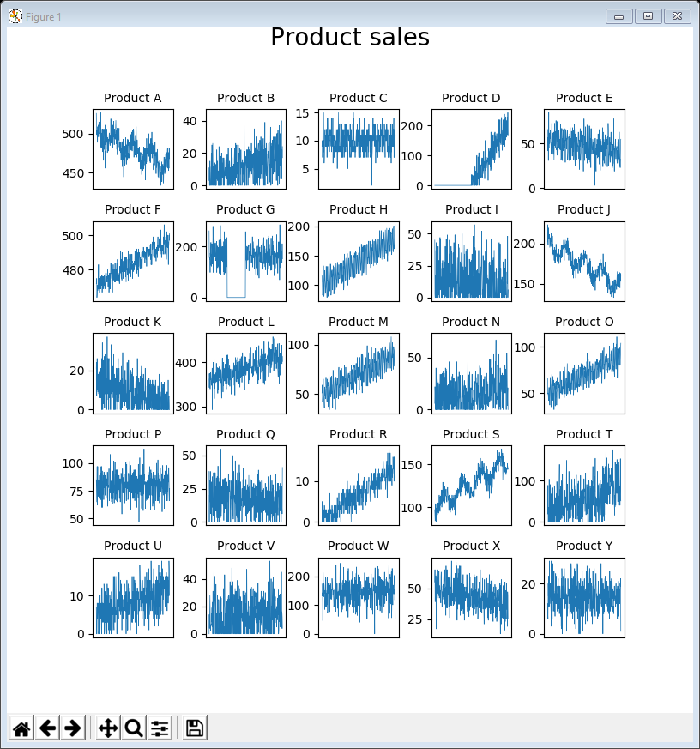
08LinePlot all subplots.py
Let’s remind ourselves what the time-series look like for all products using the idea of faceting (subplots) from last week
The first bold line actually creates the line plots for each product
The second bold line (with set_ticks([])) removes the x tick marks to get rid of some of the clutter
As before we can see definite suggestions of seasonality in A, J & S
counter = 1
fig = plt.figure(figsize=(8, 8))
fig.suptitle('Product sales', fontsize=20,
position=(0.5, 1.0))
for name in data.columns:
sub = fig.add_subplot(5, 5, counter)
sub.set_title('Product ' + name, fontsize=10)
sub.plot(data.index, data[name], linewidth=0.5)
sub.axes.get_xaxis().set_ticks([]) # remove x ticks
counter += 1
plt.subplots_adjust(wspace=0.4, hspace=0.4)
plt.show()

Slide 16
Autocorrelation plots
One way to explore seasonality is via an autocorrelation plot
Here’s the idea … suppose a time-series has regular weekly peaks on a Saturday …
… if we measure the correlation between the time-series and itself, but a week earlier (i.e. a lag of 7 days), or two weeks earlier (a lag of 14 days), there should be a high correlation
Autocorrelation takes this further and measures the correlation of a time-series with itself for every possible lag (i.e. 1 day, 2 days, … 364 days)
It’s possible to do autocorrelation in MatPlotLib but Pandas itself uses a higher level visualisation of the autocorrelation values and so is easier to interpret

Slide 17
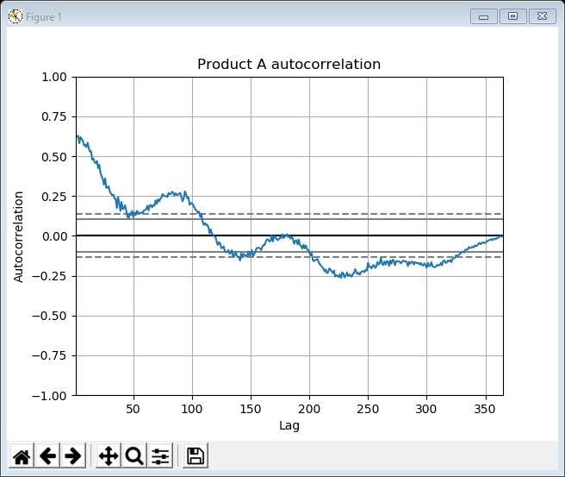
09Autocorrelation A.py
Let’s start with product A
an autocorrelation plot for a time-series is remarkably easy to achieve with Pandas
To check seasonality look at the largest secondary peak
the initial peak is for 0 lag (i.e. correlated with itself)
Anything in between the dashed lines is not statistically significant
pd.plotting.autocorrelation_plot(data['A'])
plt.title('Product A autocorrelation' )
plt.show()
secondary peak here at ~90 days … so this time series exhibits quarterly seasonality

Slide 18
Subplot code
Let’s check out all the time series autocorrelations using faceting
the code is slightly different to last week because we are using Pandas
set up the row and column counters
create the figure and specify how many rows / columns
add another Pandas subplot specifying the row and column
update the row and column counters ready for the next subplot
row = 0
col = 0
fig, axes = plt.subplots(figsize=(8, 8), nrows=5, ncols=5)
fig.suptitle('FIGURE TITLE', fontsize=20, position=(0.5, 1.0))
for name in data.columns:
sub = pd.plotting.[pandas function](data[name], axes[row, col])
sub.set_title('Subplot Title', fontsize=10)
col += 1
if col == 5:
row += 1
col = 0
plt.subplots_adjust(wspace=0.5, hspace=0.5)
plt.show()

Slide 19
10Autocorrelation all.py
Here’s the whole code
Set the axis label as not visible to reduce clutter
row = 0
col = 0
fig, axes = plt.subplots(figsize=(8, 8), nrows=5, ncols=5)
fig.suptitle('Autocorrelation plots', fontsize=20, position=(0.5, 1.0))
for name in data.columns:
sub = pd.plotting.autocorrelation_plot(data[name], axes[row, col])
sub.set_title('Product ' + name, fontsize=10)
sub.xaxis.label.set_visible(False)
sub.yaxis.label.set_visible(False)
col += 1
if col == 5:
row += 1
col = 0
plt.subplots_adjust(wspace=0.5, hspace=0.5)
plt.show()

Slide 20
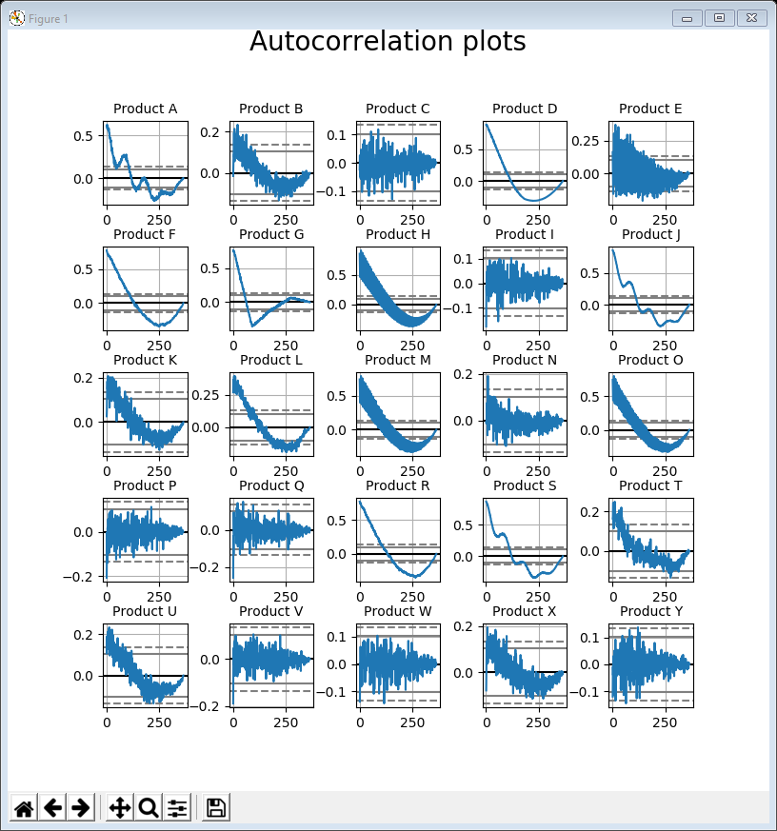
10Autocorrelation all.py
So products A, J, S have quarterly seasonality
And products H, M, O are worth investigating further
hard to see but A, J & S have secondary peaks outside the dashed lines
also H, M & O have some very high correlations (> 0.5)

Slide 21
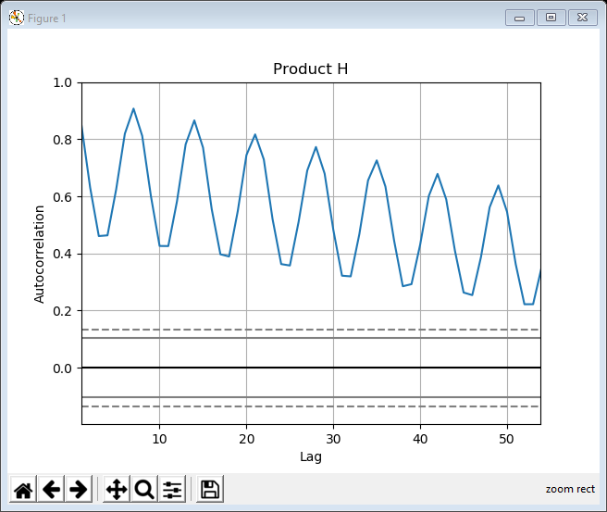
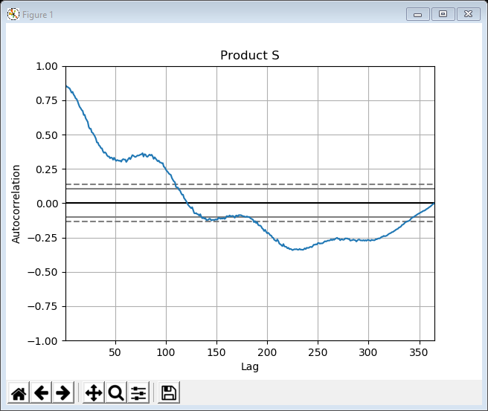
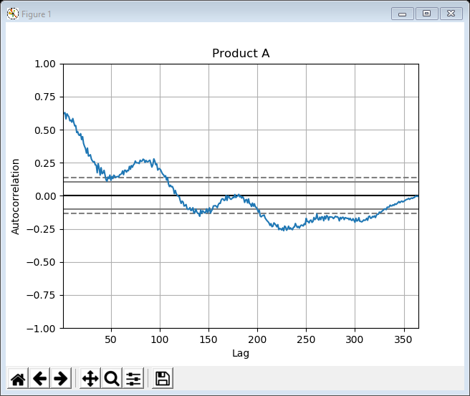

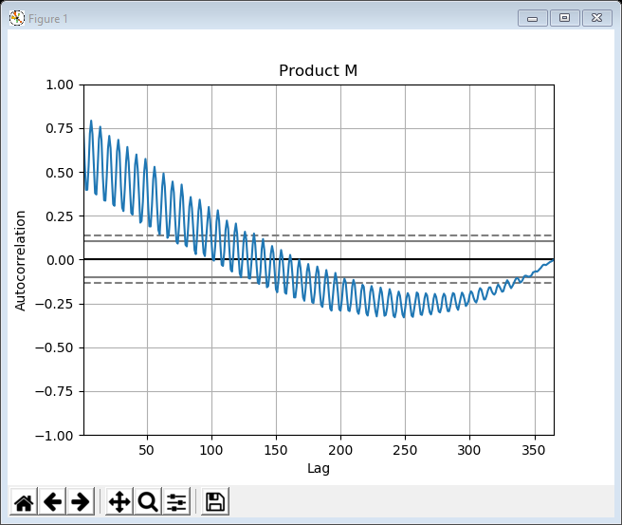
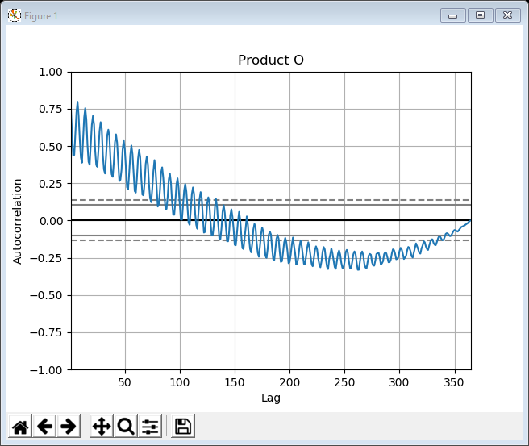
11Autocorrelation selected.py
The next example just loops through the products of interest showing the autocorrelations
Products A, J, S are all similar with a peak at around ~90 days
J & S are less noisy / clearer than A
Products H, M, O quite striking
can limit the x-axis to zoom in (uncomment the plt.xlim line)
peaks at 7, 14, 21, 28, … days, so weekly seasonality
selected = ['A', 'J', 'S', 'H', 'M', 'O']
for name in selected:
pd.plotting.autocorrelation_plot(data[name])
# plt.xlim([0, 50]) # uncomment this line to zoom in
plt.title('Product ' + name)
plt.show()

Slide 22
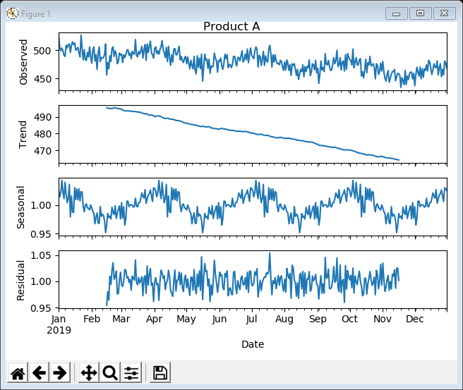
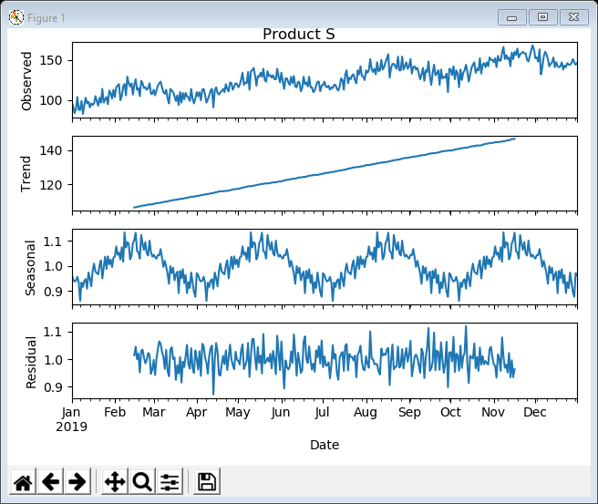
12LinePlotDecomposition quarterly.py
We can use a specialist statistics package to decompose the time-series into trend, seasonal variation and residual noise
A quarter is 365 / 4 = 91.25 days so freq is set to 91
The plots help explain what is happening
for A the trend is downwards, with quarterly seasonality & some noise (1.05)
for S the trend is upwards, with quarterly seasonality & more noise (1.1)
from statsmodels.tsa.seasonal
import seasonal_decompose
selected = ['A', 'J', 'S']
for name in selected:
result = seasonal_decompose(data[name],
model='multiplicative', freq=91)
result.plot()
plt.suptitle('Product ' + name,
position=(0.5, 1.0))
plt.show()

Slide 23
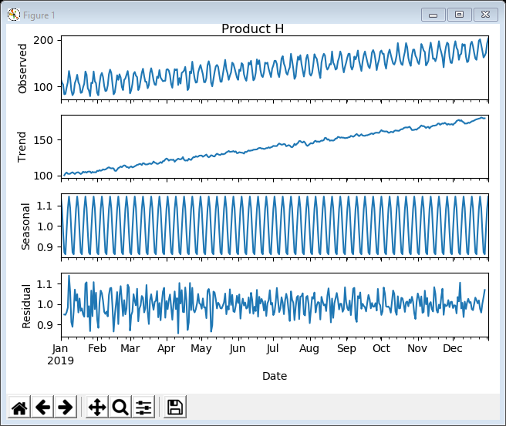
13LinePlotDecomposition weekly.py
Likewise we can look at weekly decompositions
Just change the selected products and the frequency to 7
For H the trend is upwards with weekly seasonality and some noise
from statsmodels.tsa.seasonal
import seasonal_decompose
selected = ['H', 'M', 'O']
for name in selected:
result = seasonal_decompose(data[name],
model='multiplicative', freq=7)
result.plot()
plt.suptitle('Product ' + name,
position=(0.5, 1.0))
plt.show()

Slide 24
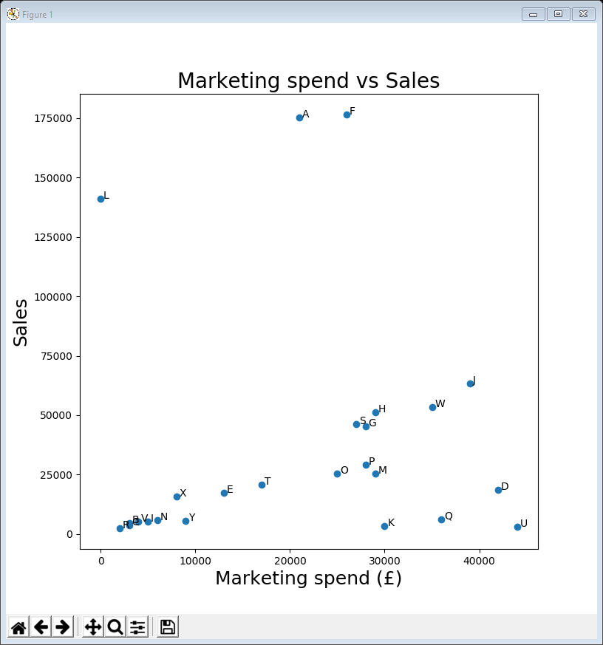
14ScatterPlot marketing vs sales.py
If we are not dealing with time-series can’t consider seasonality
but still worth looking at distribution and outliers with bespoke ideas
Returning to example 11 from last week (marketing vs sales), we can label / annotate each circle to identify outliers
The value 300 is just to offset the label
need to adjust depending on scale
Can identify possible outliers by position
A, F & L … the high volume products – marketing not correlated with sales
D, K, Q & U … what are these?
plt.figure(figsize=(8, 8))
plt.scatter(summary_data['Marketing'],
summary_data['Sales'])
plt.title('Marketing spend vs Sales', fontsize=20)
plt.xlabel('Marketing spend (£)', fontsize=18)
plt.ylabel('Sales', fontsize=18)
for i, name in enumerate(data.columns):
plt.annotate(name, (summary_data['Marketing'][i] + 300,
summary_data['Sales'][i]))
plt.show()

Slide 25
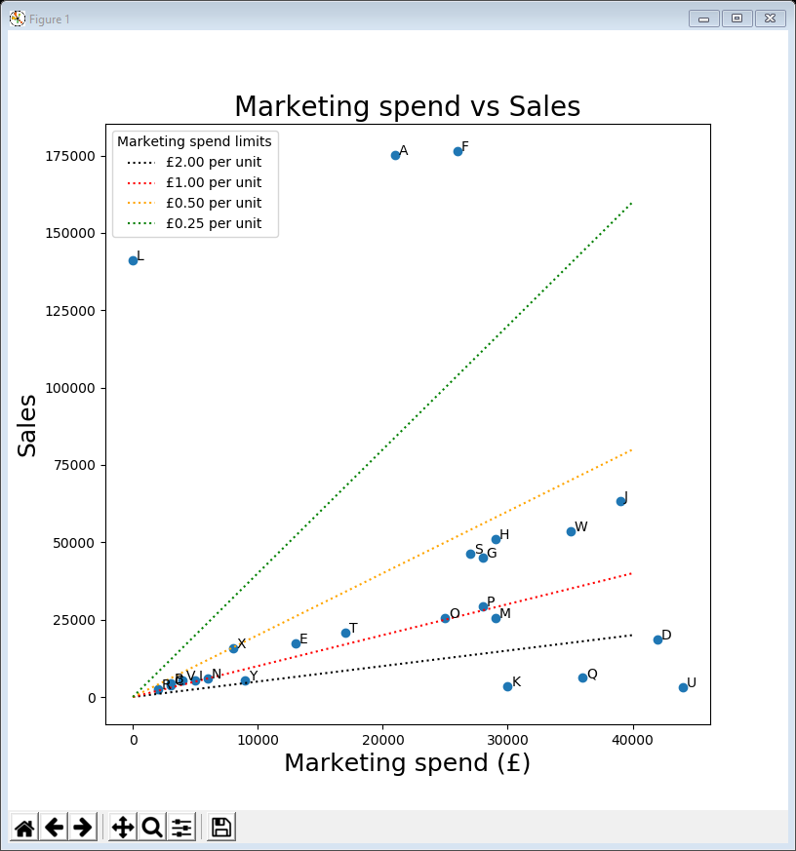
15ScatterPlot marketing vs sales outliers.py
A way to clarify outliers is to add some lines representing expected values
A line with x values 0 to 40,000 and y values of 0 to 40,000 represents a marketing spend of £1.00 per sale (£40,000 for 40,000 sales)
A line with x values of 0 to 40,000 and y values of 0 to 80,000 represents a marketing spend of £0.50 per sale (£40,000 for 80,000 sales)
…
Now we can see that A, F & L have very low marketing spend per sale (probably because they are high volume)
Whereas D, K, Q & U have more than £2 per sale spent – may be excessive
plt.plot([0, 40000], [0, 20000], linestyle=':',
color='black', label='£2.00 per unit')
plt.plot([0, 40000], [0, 40000], linestyle=':',
color='red', label='£1.00 per unit')
plt.plot([0, 40000], [0, 80000], linestyle=':',
color='orange', label='£0.50 per unit')
plt.plot([0, 40000], [0, 160000], linestyle=':',
color='green', label='£0.25 per unit')
plt.legend(loc=2, title='Marketing spend limits')
plt.show()

Slide 26
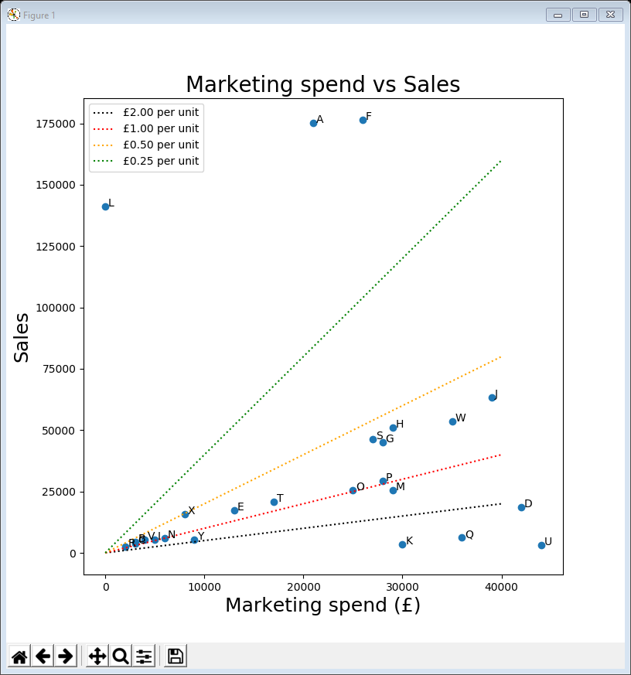
Data conclusions
Reminder - we are not making business recommendations
let the business analyst decide what to do
However …
can visualise distributions and outliers in the time-series
can spot some seasonal variations, particularly quarterly & weekly, but only for some products
can identify & label outliers (e.g. with very high and very low marketing spend per sale)

Slide 27
Lecture summary
Looked at visualising distribution, seasonality & outliers
histograms
box plots
autocorrelation
seasonal decomposition
outliers
There are other ways of visualising distribution
density plots (smoothed version of the histogram)
violin plots (combination of a density plot and a box plot)
A toolbox of techniques
some techniques suit certain datasets better than others

